Slide 1
CSE7302 - INTERNSHIP Review-4 Presentation TITLE OF THE INTERNSHIP / WORK ASSIGNED / DOMAIN
Student Details
Name | VENKATA HEMANTH.N
Roll No | 20221CBD0007
Section | 08CBD-01
Under the Supervision of,
Ms. Thabassum Khan
Assistant Professor
Presidency School of CSE
Presidency University
Name of the Program: B.tech Computer Science and Technology (Big Data)
Name of the HoD: Dr. Pravinth Raja
Name of the Program Internship Coordinator: Ms. Nisha Robin Rohit
Name of the School Internship Coordinator: Dr. Md Ziaur Rahman

Slide 2
Content
About Company or Organization
Working domain or the technology
About your team and reporting Manager
Challenges Faced in Internship
Objectives of the work
Literature Review
Proposed System
Problem Statement
System Requirements
Advantages of Proposed System/Work
System Design
System Implementation
System Testing
Conclusion
References
Github Link

Slide 3
About Company or Organization
Rittal India Private Limited is a leading company that provides industrial and IT infrastructure solutions, specializing in enclosure systems, power distribution, thermal management, and data center solutions. It is a subsidiary of Rittal GmbH & Co. KG, Germany, part of the Friedhelm Loh Group.
Subsidiary of Rittal GmbH & Co. KG, Germany
Established in India in 1996
Provides industrial and IT infrastructure solutions
Major products include enclosures, cooling systems, power distribution, and IT infrastructure

Slide 4
Products & Solutions :
Industrial Enclosures & Cabinets
Protect electrical and electronic components
Climate Control Systems
Cooling units for industrial and IT environments
Power Distribution Solutions
Efficient and safe energy management systems
IT Infrastructure Solutions
Data center racks, servers, and monitoring systems
Automation & Smart Manufacturing Tools
Supports digital transformation in industries

Slide 5
Working domain or the technology
Domain: Research & Development (R&D)
Role: Software Developer Intern
Working as a Software Developer Intern in the R&D domain
Currently in the office I am developing web Application .
Completed Developing the web application using HTML,CSS,JavaScripy and succesfuly connected to Backend Json Database using REST API .
Gaining knowledge on full stack development .

Slide 6
About your team and reporting Manager
Team Size: 1 Member
Team Composition: Research & Development (R&D) – Embedded Software Developer Intern
Current Activity:
Developed web applications using HTML5, CSS, and JavaScript for frontend
Gained hands-on experience in building full-stack projects
Worked with REST APIs for backend communication
Created and managed data using JSON-based database structures
Reporting: Guided by an Internship Mentor for regular progress reviews and performance evaluation

Slide 7
Challenges Faced in Internship
Faced multiple challenges while developing the project from scratch
UI Alignment Issues: Difficulty in maintaining proper layout and responsiveness using CSS
Logic Building Challenges: Complexity in implementing dynamic functionalities using JavaScript
Frontend–Backend Integration: Major challenge in connecting the frontend application with backend and database

Slide 8
API & HTTP Communication: Understanding and implementing HTTP protocols and REST APIs for data transfer
Data Storage Issues: Ensuring that data is correctly sent, processed, and stored in the database (JSON files)

Slide 9
Objectives of the work
Purpose of the Project:
To develop a web-based monitoring system for industrial cooling environments
To enable real-time monitoring of critical system parameters
To detect abnormal conditions using threshold-based alarm system
To improve system safety, reliability, and efficiency
Usage of the System:
Used by operators to monitor sensor values (temperature, pressure, flow, etc.)
Helps in early fault detection and prevents system failure
Provides visual troubleshooting panel for quick issue identification
Maintains historical data logs for analysis and reporting
Can be applied in industrial automation and smart monitoring systems

Slide 10
Literature Review
Industrial monitoring systems are used to observe parameters like
temperature, pressure, and flow .
Traditional systems such as SCADA and PLC provide real-time monitoring and control
These systems are reliable but expensive and require complex hardware setup
Modern systems use web technologies (HTML, CSS, JavaScript, Node.js)
for monitoring.
Monitoring systems use threshold-based alarms to detect abnormal conditions
Existing systems mainly provide text-based alerts, making fault identification difficult
To overcome this, the proposed system uses a graphical troubleshooting interface for
better fault detection

Slide 11
Proposed System / Work
Developed a web-based Sensor Monitoring System for industrial cooling environments
System monitors parameters like: Temperature, Pressure, Flow, Pump, Valve, and Leak Detection
Implemented real-time data display through an interactive dashboard
Designed a client–server architecture using frontend and backend integration
Used REST APIs for communication between frontend and backend
Implemented threshold-based alarm system to detect abnormal conditions
Developed a graphical troubleshooting panel to visually identify faults
Added role-based access control (Admin & User)
Implemented data storage using JSON files and Excel logging for history

Slide 12
Problem Statement
Industrial cooling systems require continuous monitoring of critical parameters
Traditional monitoring methods face issues such as:
Delayed fault detection
Lack of real-time visibility
Complex and costly systems (SCADA/PLC)
Existing systems mostly provide text-based alerts, making fault identification difficult
Absence of user-friendly and visual monitoring tools
Need for a cost-effective, web-based system that can:
Monitor parameters in real time
Detect abnormal conditions early
Provide visual troubleshooting for quick fault identification

Slide 13
System Requirements
A computer system with a web browser to access the monitoring dashboard.
Node.js environment to run the backend server.
Internet or local network connection for communication between frontend and backend.
Software tools such as VS Code for developing and editing the project.
Libraries such as Express.js and XLSX for server operations and data logging.
Storage to save sensor data logs and configuration files.

Slide 14
Advantages of Proposed System/Work
Real-Time Monitoring: Enables continuous tracking of system parameters
Early Fault Detection: Detects abnormal conditions using threshold-based alarms
Graphical Troubleshooting: Visual representation helps in quick identification of faults
User-Friendly Interface: Easy-to-use dashboard for monitoring and navigation
Cost-Effective Solution: Eliminates need for expensive hardware systems like SCADA

Slide 15
Role-Based Access Control: Secure system with Admin and User permissions
Efficient Data Management: Uses JSON for storage and Excel logging for history
Scalable System: Can be extended with more sensors and advanced features

Slide 16
System Design
The system follows a 3-layer architecture:
Frontend (User Interface)
Backend (Application Logic)
Data Storage Layer
Frontend Design:
Developed using HTML, CSS, JavaScript
Provides dashboard, sensor page, troubleshooting panel, and configuration page
Backend Design:
Built using Node.js and Express.js
Handles API requests, system logic, and alarm detection

Slide 17
Data Storage:
Sensor data and configuration stored in JSON files
Historical data maintained using Excel logging system
Communication:
Uses REST APIs and HTTP protocols for frontend–backend interaction
Access Control:
Supports Admin (full access) and User (read-only access)

Slide 18
System Implementation
The system was implemented as a full-stack web application
Frontend Implementation:
Developed using HTML, CSS, and JavaScript
Designed interactive pages: Dashboard, Sensors, Troubleshooting, Configuration
Backend Implementation:
Built using Node.js and Express.js
Developed REST APIs for data communication
Data Handling:
Sensor values and configurations stored in JSON files
Data processed and updated dynamically

Slide 19
Alarm Detection Logic:
Sensor values compared with predefined thresholds
System triggers alarm status when limits are exceeded
Troubleshooting Feature:
Visual system diagram highlights fault locations
Data Logging:
Implemented Excel logging system to store historical data
Integration:
Successfully connected frontend, backend, and data storage

Slide 20
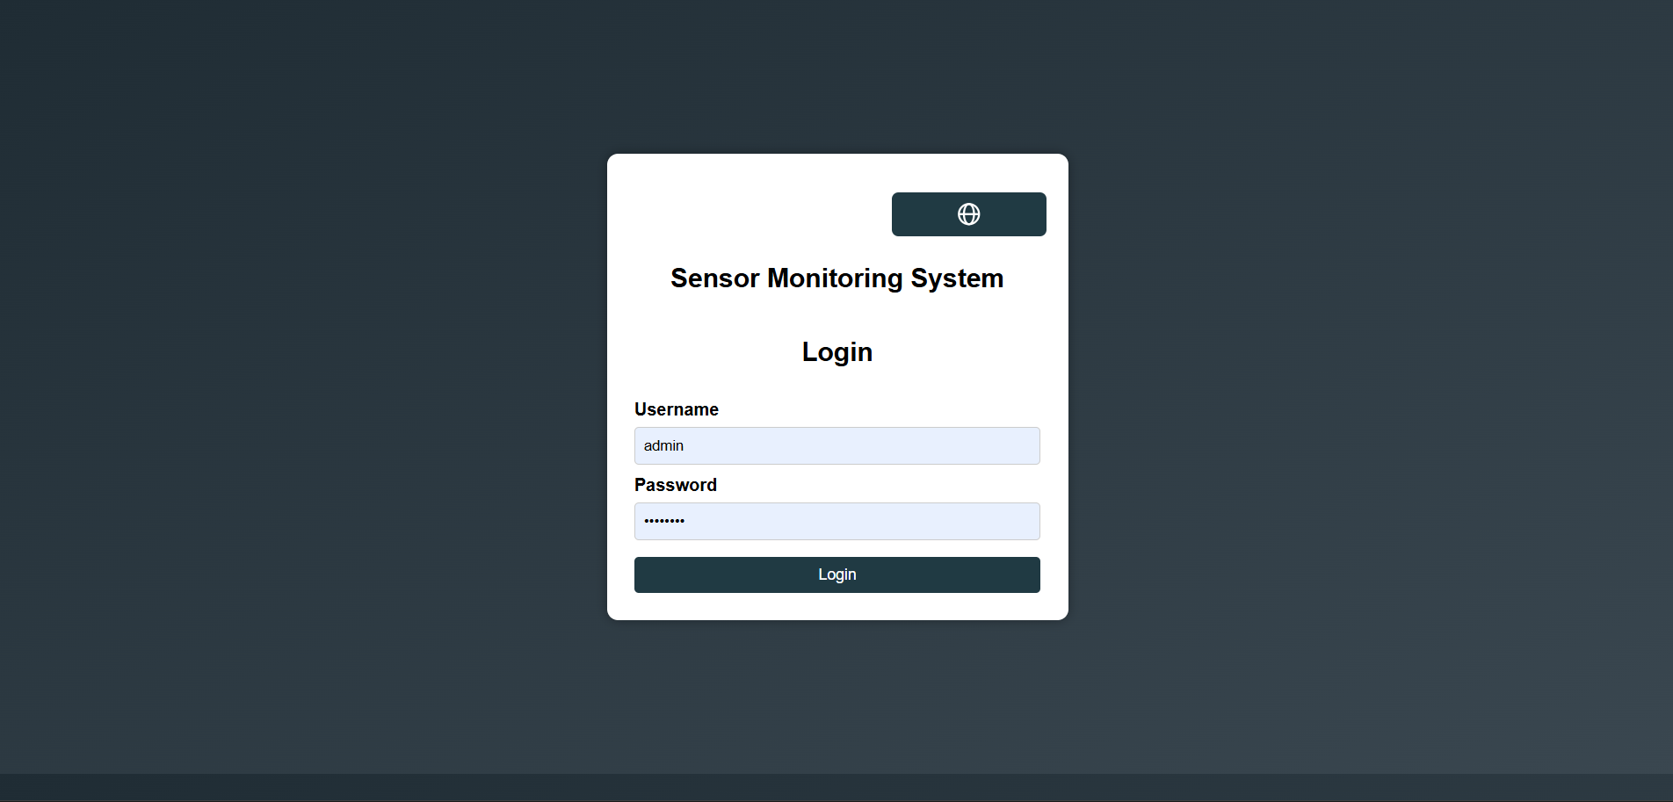

Slide 21
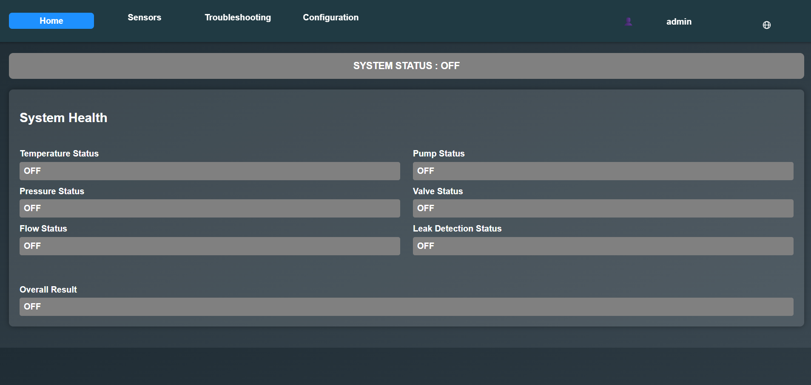

Slide 22
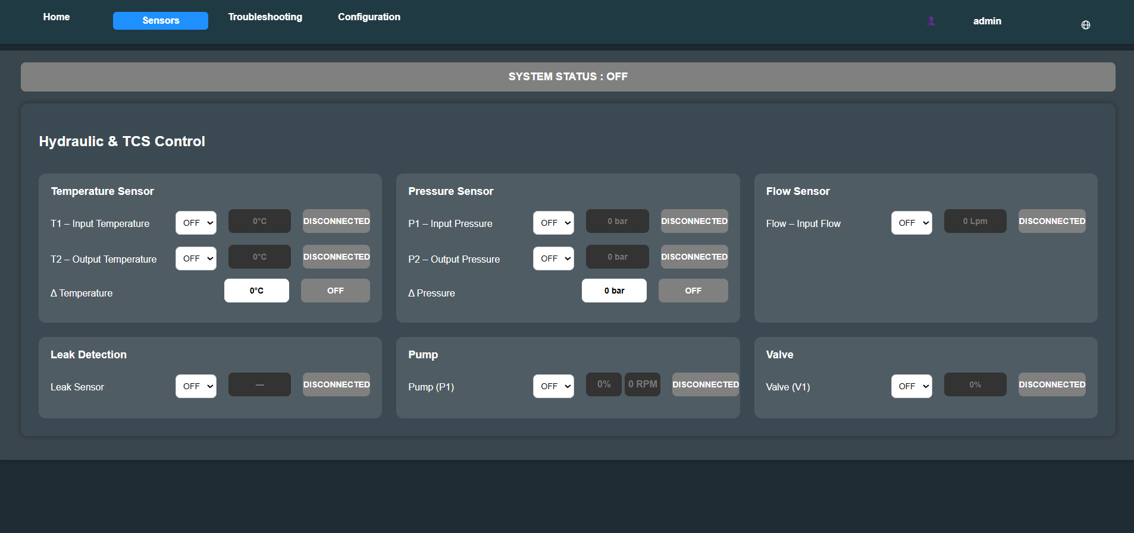

Slide 23
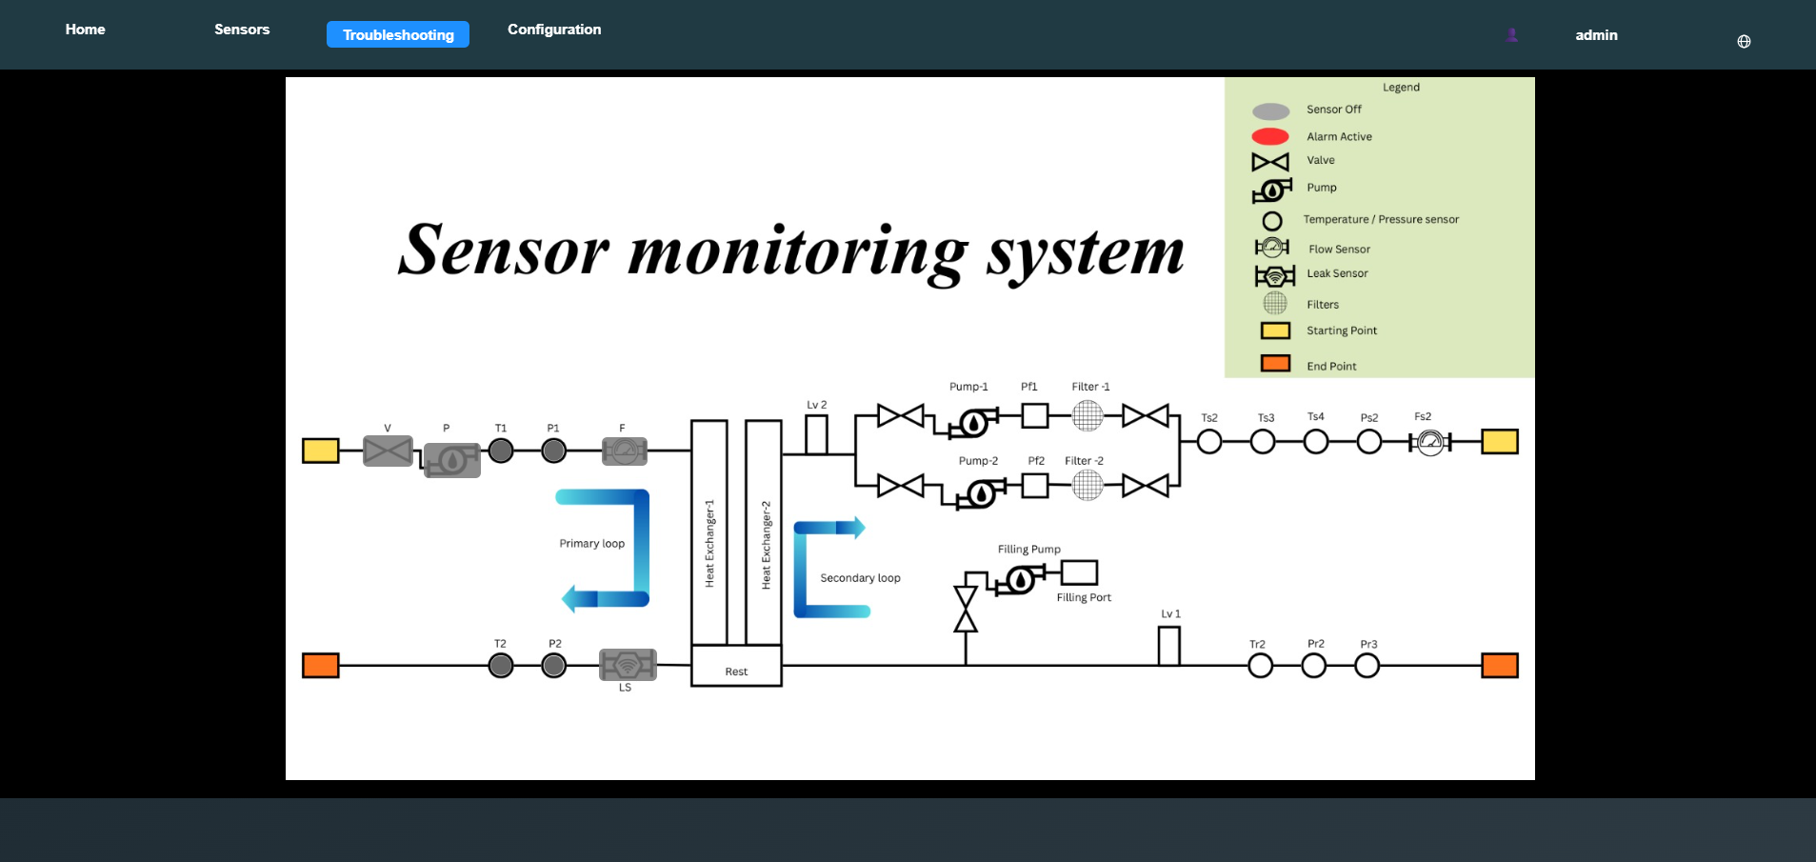

Slide 24
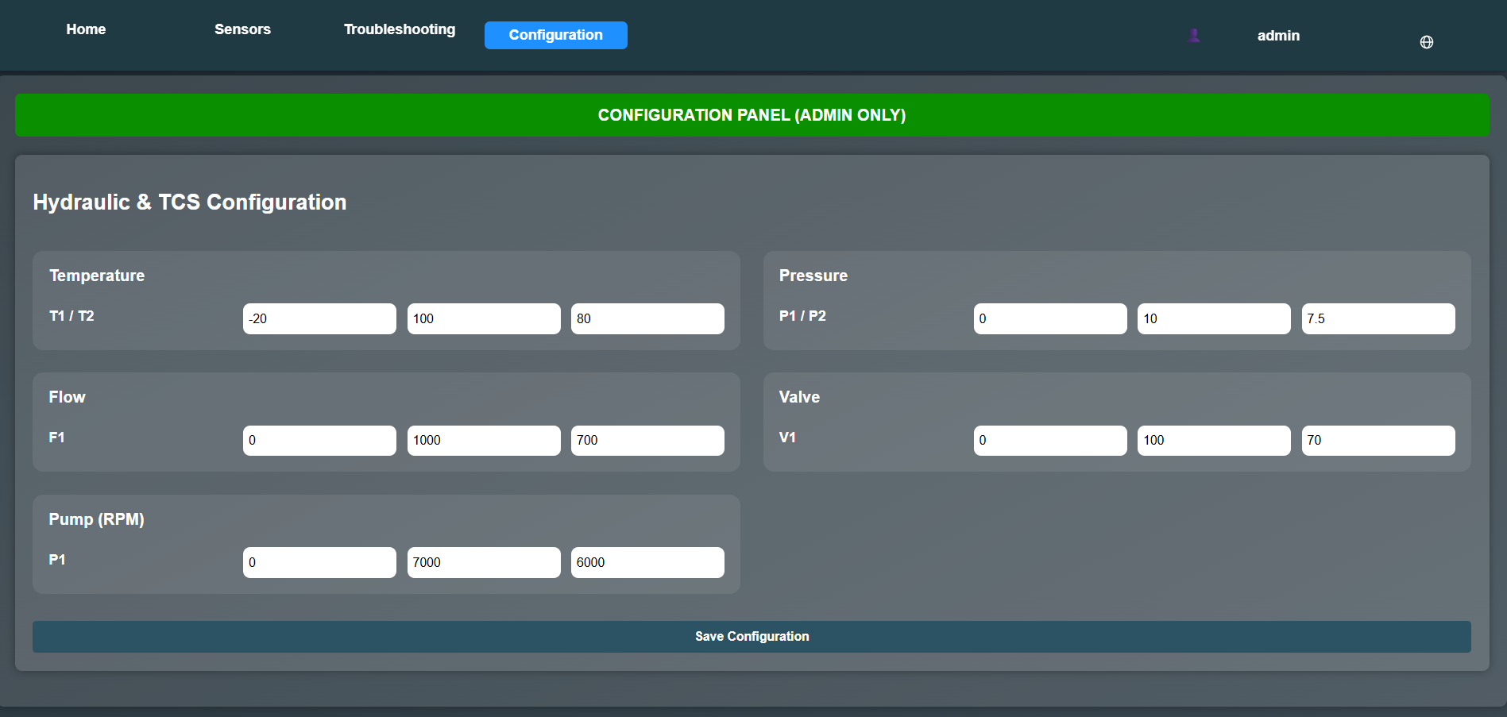

Slide 25
System Testing
System testing was performed to ensure all modules function correctly
Modules Tested: Login Authentication, Role-Based Access, Sensor Monitoring, Alarm Detection, Troubleshooting Panel, Configuration
Verified frontend–backend communication using REST APIs
Tested system under normal conditions and abnormal conditions (threshold exceeded)
Key Test Cases:
Valid & invalid login
Sensor value updates
Alarm triggering when limits exceed
Data storage in Excel logs

Slide 26
Results:
All modules worked successfully
Accurate alarm detection and visualization
Smooth data flow and storage

Slide 27
Conclusion
Successfully developed a web-based Sensor Monitoring System for industrial cooling
Achieved real-time monitoring of parameters like temperature, pressure, flow, and pump
status
Implemented threshold-based alarm detection for identifying abnormal conditions
Developed a graphical troubleshooting panel for quick fault identification
Integrated frontend, backend, and data storage using modern web technologies
Ensured secure access through Admin and User roles
System improves efficiency, reliability, and fault detection in industrial environments

Slide 28
References
Internship Report – Sensor Monitoring System
Official Documentation:
Node.js Documentation
Express.js Documentation
Web Technologies:
HTML, CSS, JavaScript (MDN Web Docs)
Concepts Referred:
REST API & HTTP Protocols
JSON Data Handling
Industrial Concepts:
SCADA Systems
PLC Systems

Slide 29
Github Link
https://github.com/naralahemanthreddy-hue/Intenship

Slide 30
Q&A

Slide 31
Thank you !!

